Slide 1

Children’s Mental Health Week
1-7 February 2021
Assembly slides for primary-age children

Slide 2
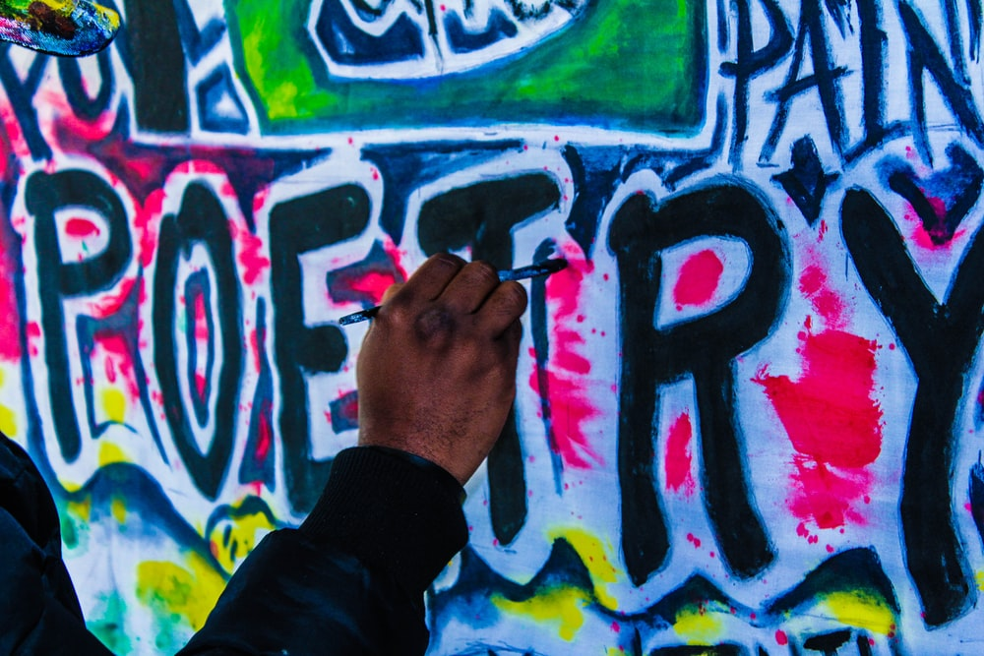
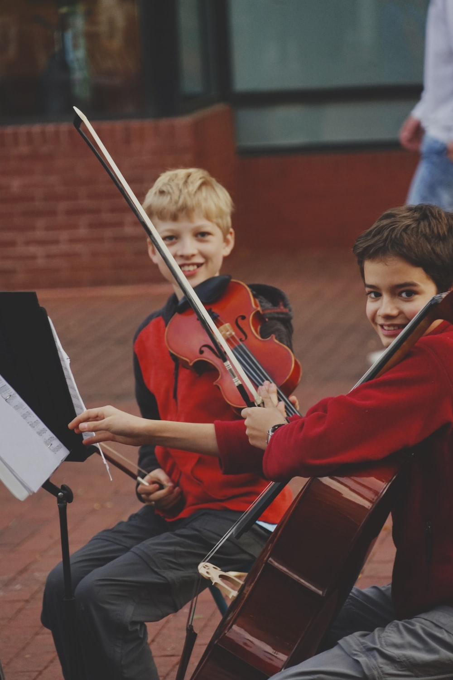
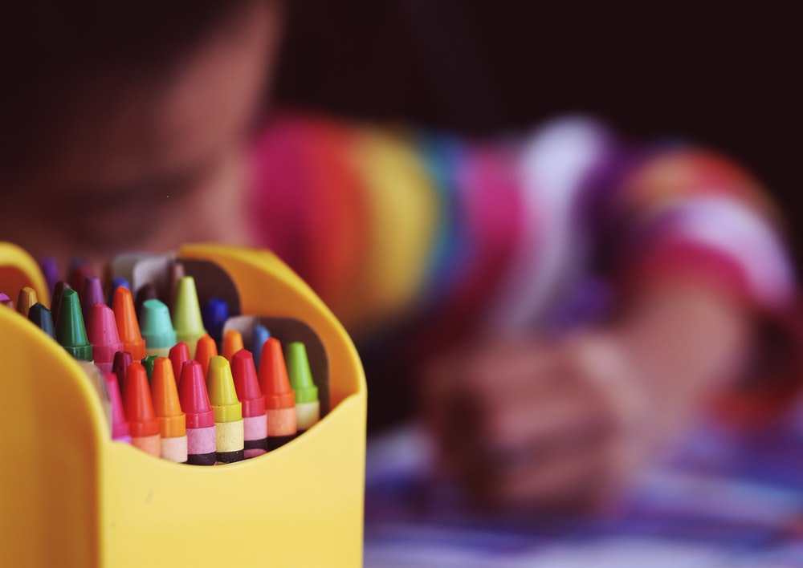
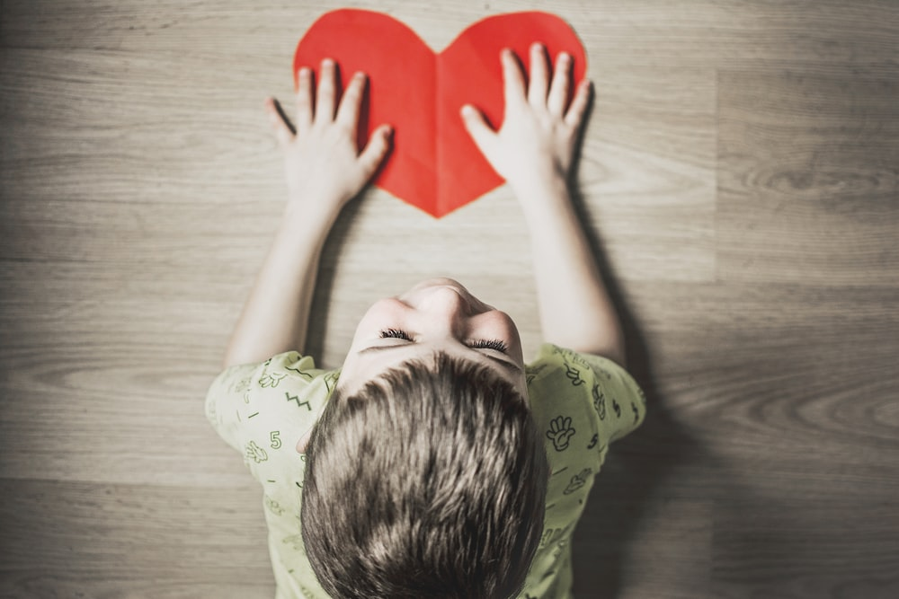
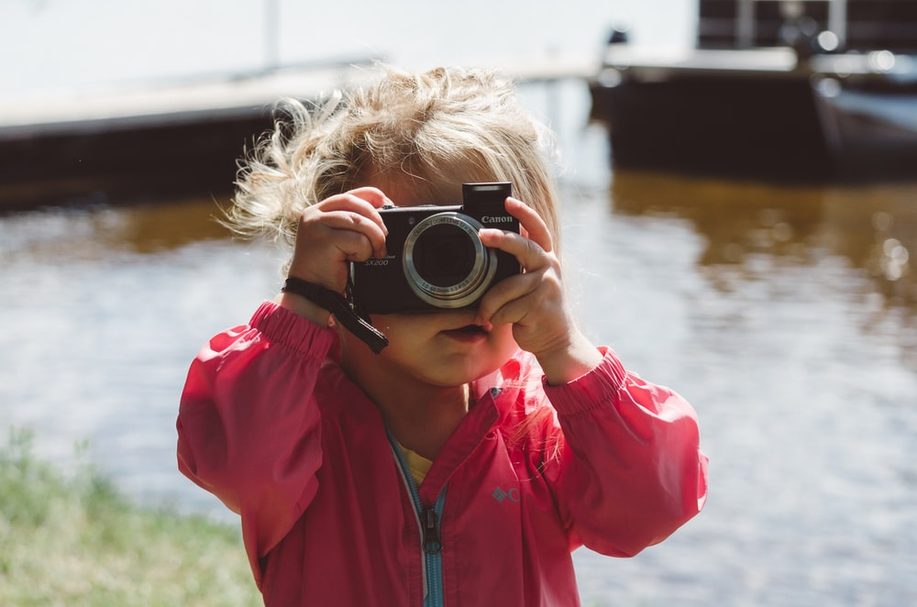
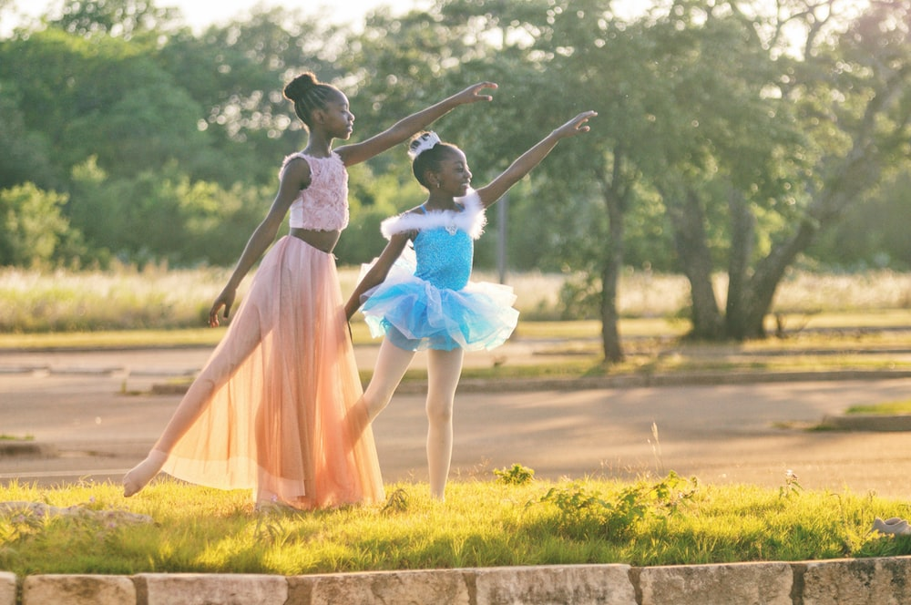
Slide 2

Slide 3

Slide 3

Slide 4
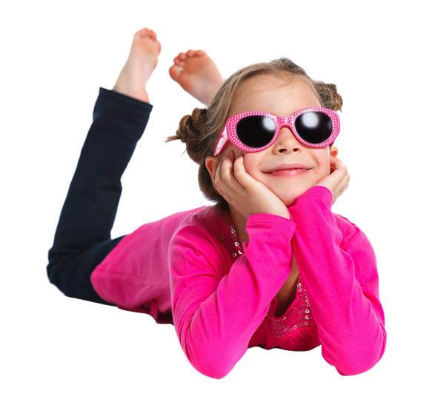
Slide 4

Slide 5

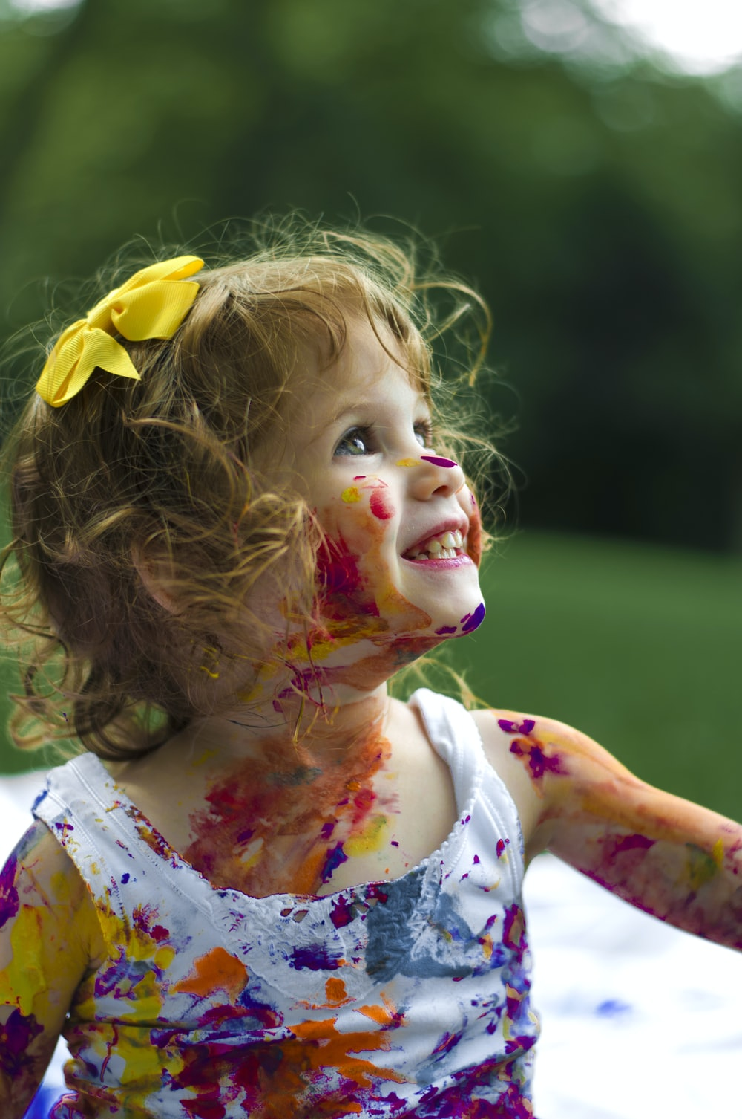
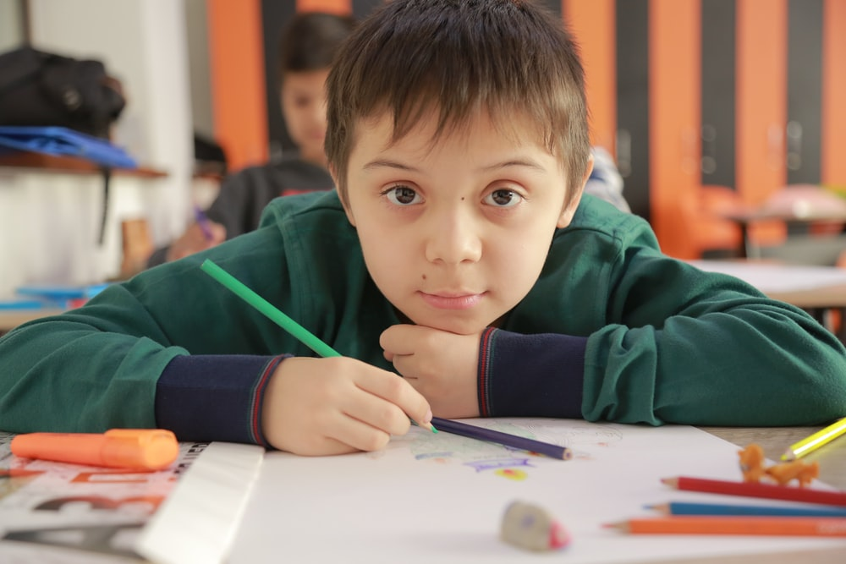
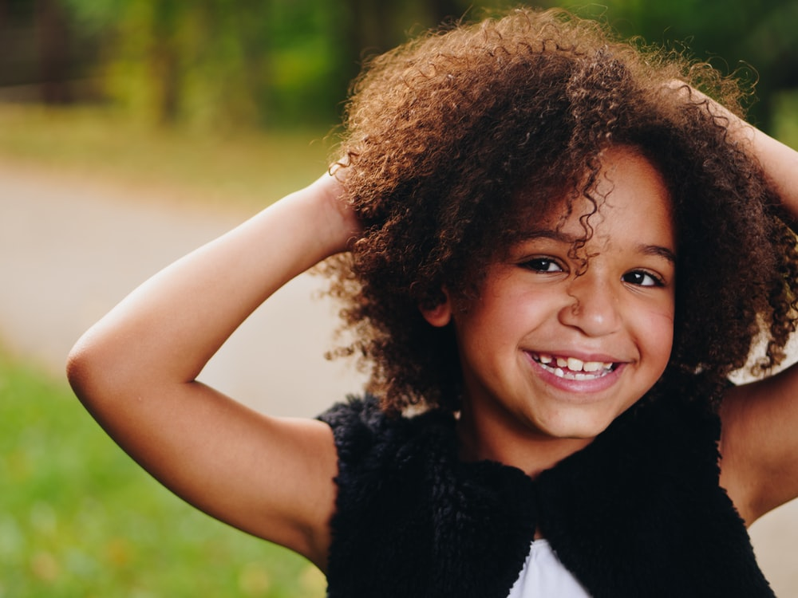
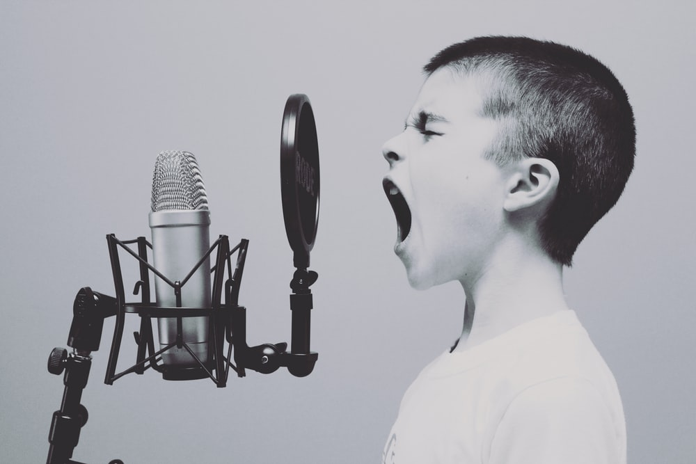
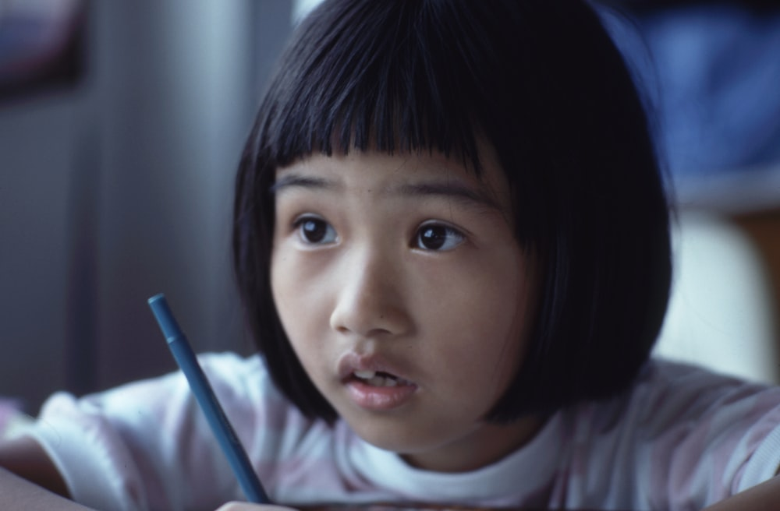
Slide 5

Slide 6

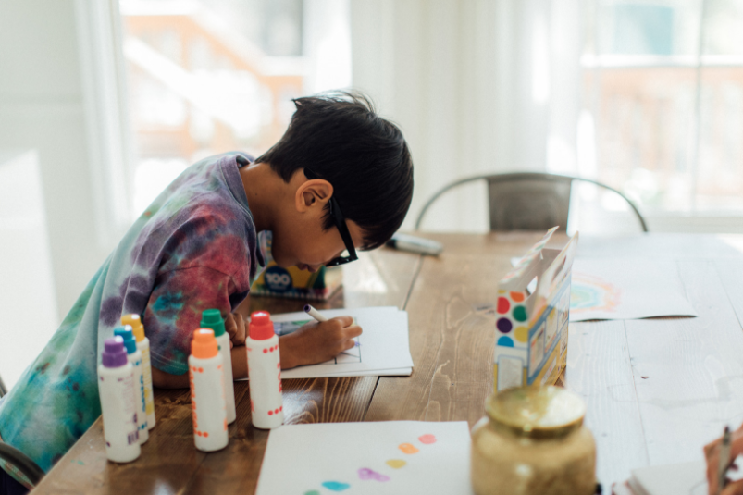
Slide 6
Listen to or read the story “Beautiful Oops” (or one of your own)
Remember, when we express ourselves we don’t have to be a great artist or a wonderful dancer.
It’s not about being the very best at something or putting on a performance.
Let’s encourage each other to find lots of different ways to get creative and express ourselves.

Slide 7



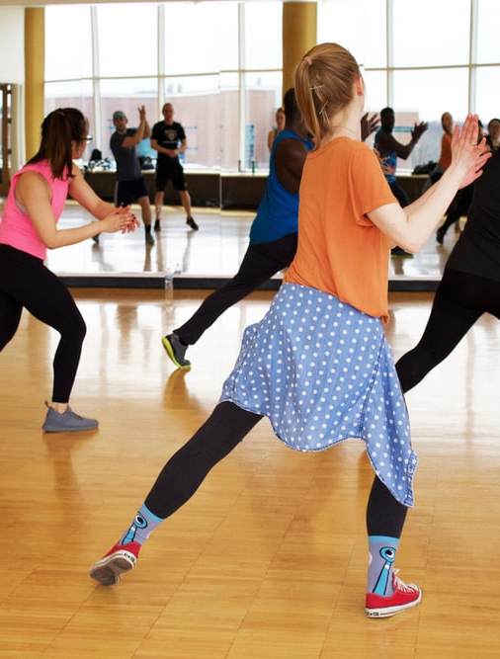
Slide 7

Slide 8
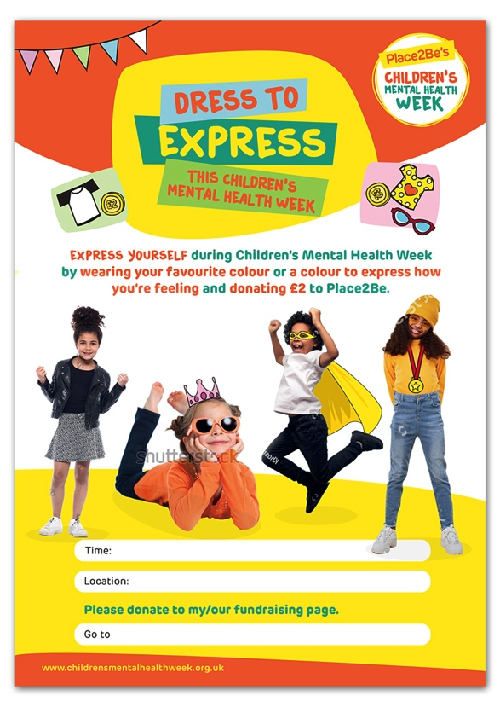


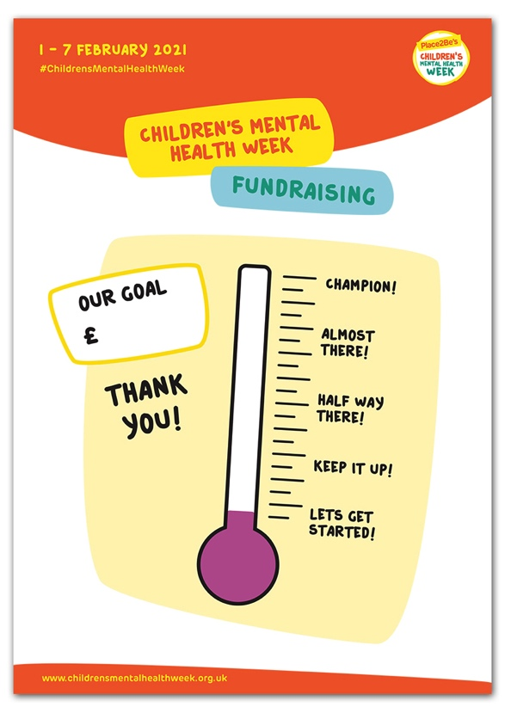
Slide 8

Slide 9

All images in this presentation are royalty free from unsplash.com and canva.com
Beautiful Oops is by Barney Saltzberg, published by Workman Publishing

